Slide 1


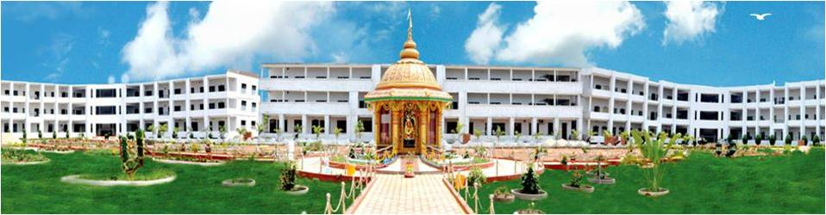
SRINIVASA
INSTITUTE OF ENGINEERING AND TECHNOLOGY
(AUTONOMOUS)
DEPARTMENT OF
ARTIFICIAL INTELLIGENCE AND MACHINE LEARNING

Slide 2
CONTENT
Faculty Details
Student Strength
Faculty Achievements
Department Activities
Result Analysis of Previous Semester
Strategic Plan And Goals

Slide 3
FACULTY DETAILS
Head of the Department
Teaching (4)
Programmers (3)
Professor (1)
Assoc. Prof (1)
Asst. Prof (2)
Programmers (3)
Department of AIML

Slide 4
STAFF DETAILS
S. No. | Name | Qualification | Designation
1 | Dr.R.Srinivas | Ph.D. | Assoc.Prof & HOD
2 | Dr. K.V.Subrahmian | Ph.D. | Professor
3 | Mr. G. Satish | M.Tech | Assistant Professor
4 | Mr. K. Vijay Babu | M.Tech | Assistant Professor
5 | Ms. Mounika | M. C. A | Programmer
6 | Ms. Priyanka | B. Tech | Programmer
7 | Ms. Pravallika | B. Tech | Programmer

Slide 5
STUDENT STRENGTH
S. No | Year | Section | Strength
1 | II (2023-27) | AIML | 122
2 | III (2022-26) | AIML | 62
3 | IV (2021-25) | AIML | 70
Total Student Strength |  |  | 254

Slide 6

FACULTY ACHIEVEMENTS
Faculty Publications : 3
FDP’s Attended : 9
NPTEL Certification Course: 3
Patents : 5
Conferences : 3
Books published :4
Faculty appreciation on the occasion of teacher day-2

Slide 7
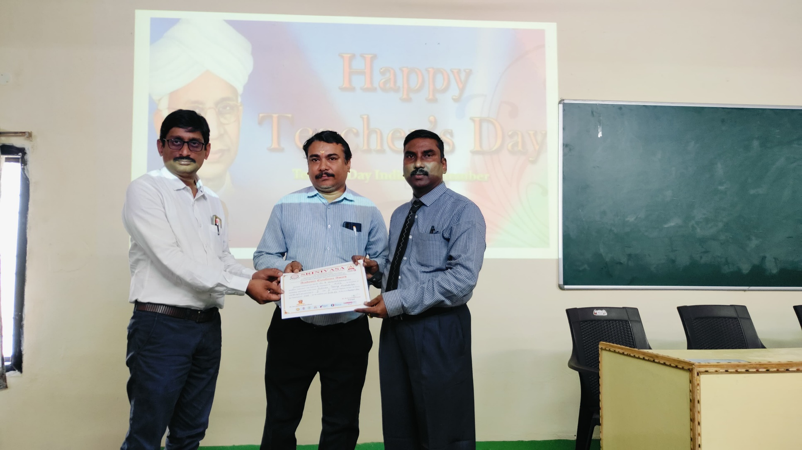
FACULTY APPRECIATION

Slide 8
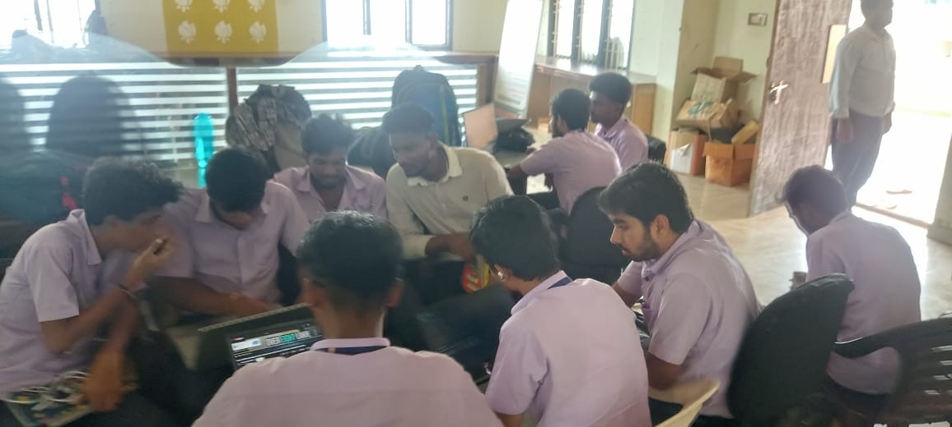
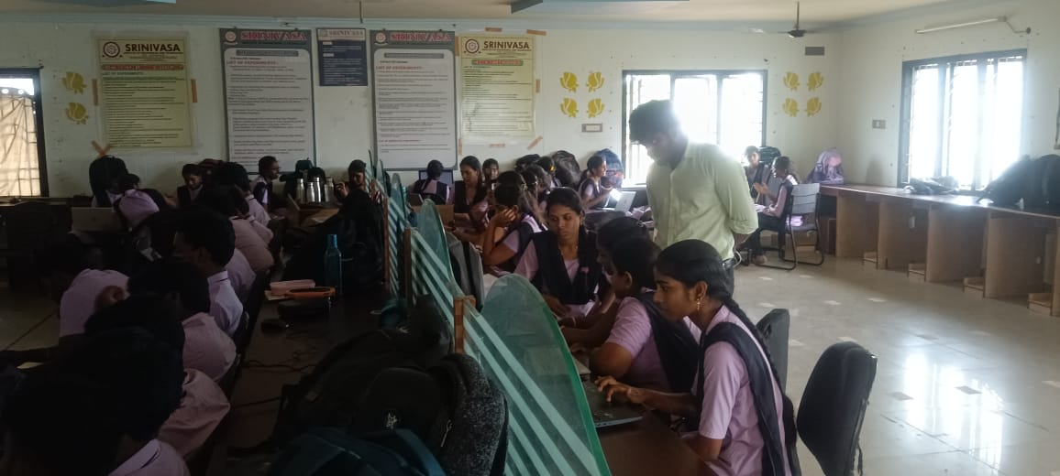
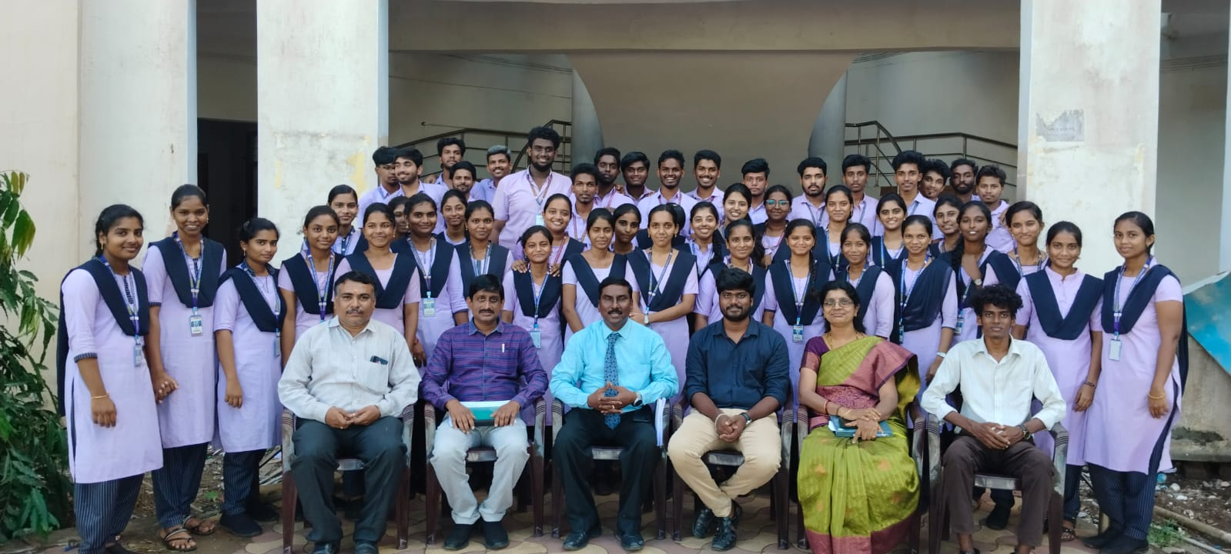
DEPARTMENT ACTIVITIES
5 Days hands on training on IOT for 3rd year Students collaboration with “ Meck Tech Research Foundation ” from 14-10-2024 to 18-10-2024

Slide 9
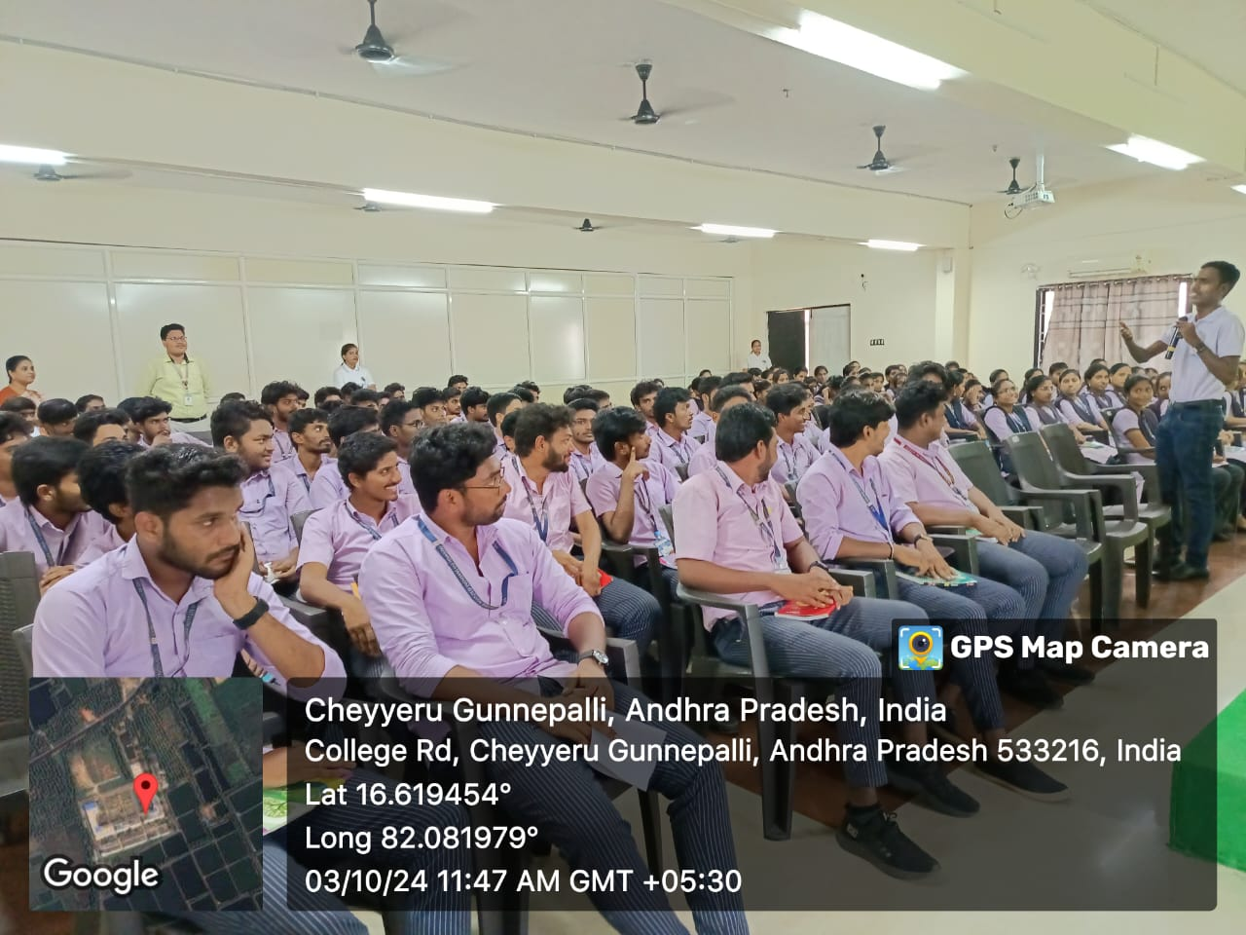
DEPARTMENT ACTIVITIES
Career Guidance Program for IV Year students on 03-10-2024 by ODIGOS Software Training Institute

Slide 10
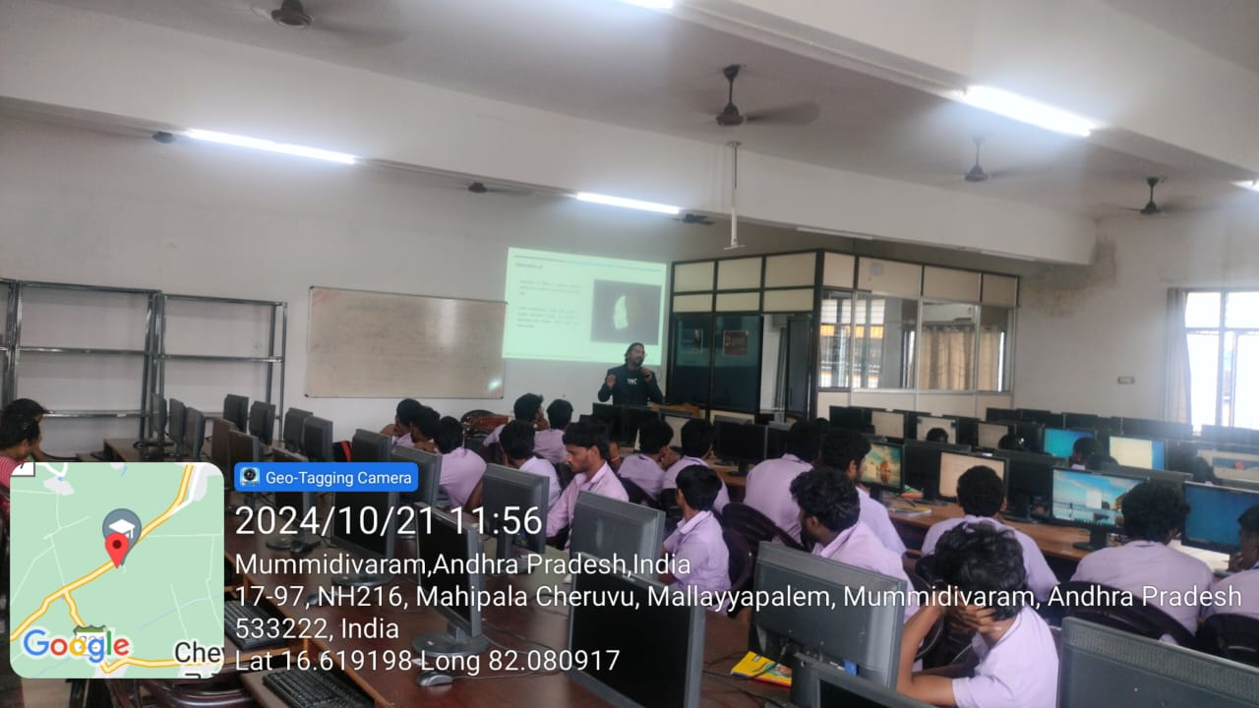
IBM Skill built Training for 3rd year (21/10/2024 to 22/10/2024)

Slide 11
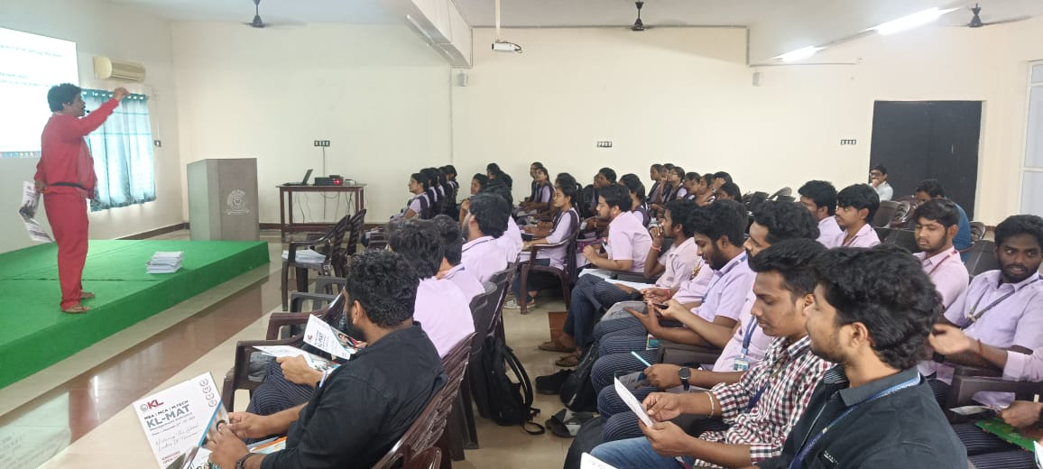
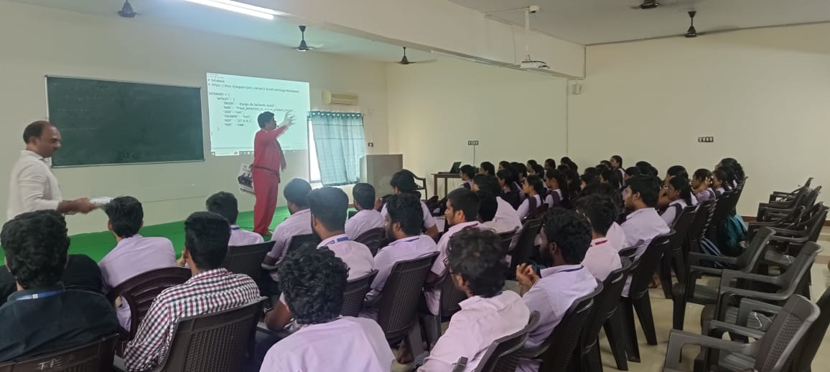
Career Planning After B.Tech By K L University (12-12-2024)

Slide 12
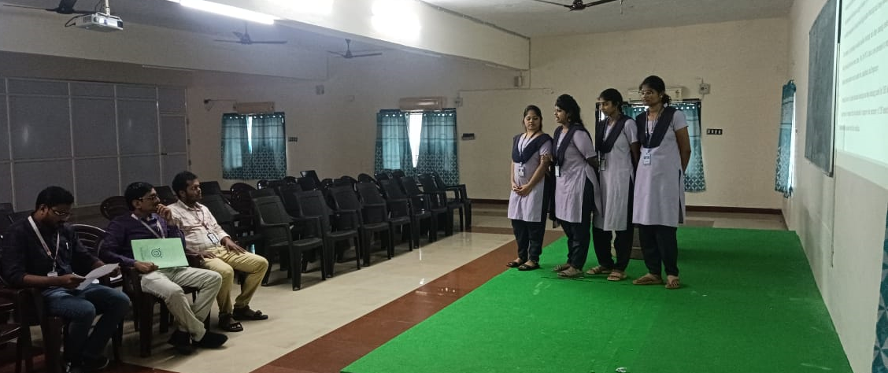
IV Year Project Reviews

Slide 13
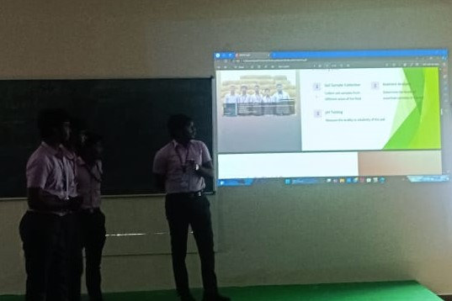
III Year CSP Reviews (17 Batches)

Slide 14
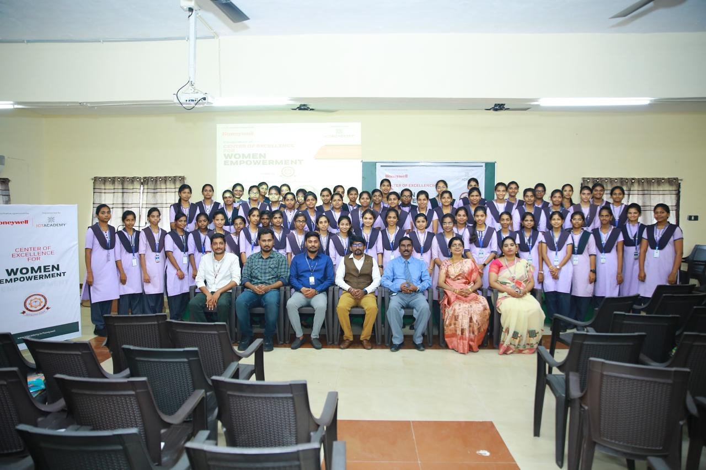
ICT ACADEMY- HONEYWELL PROGRAM

Slide 15
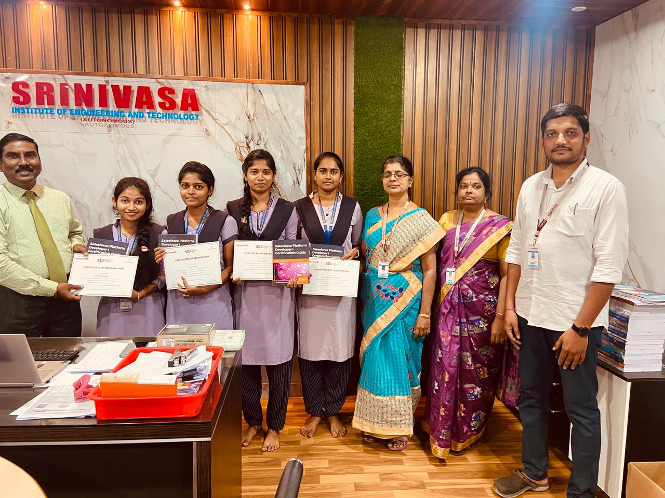
ICT TRAINING CERTIFICATES

Slide 16
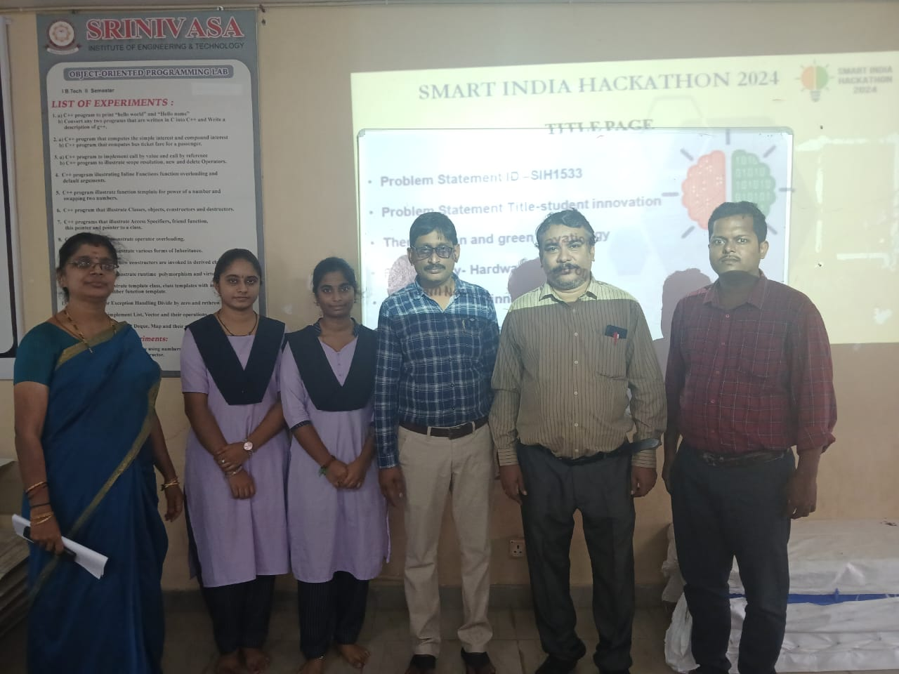
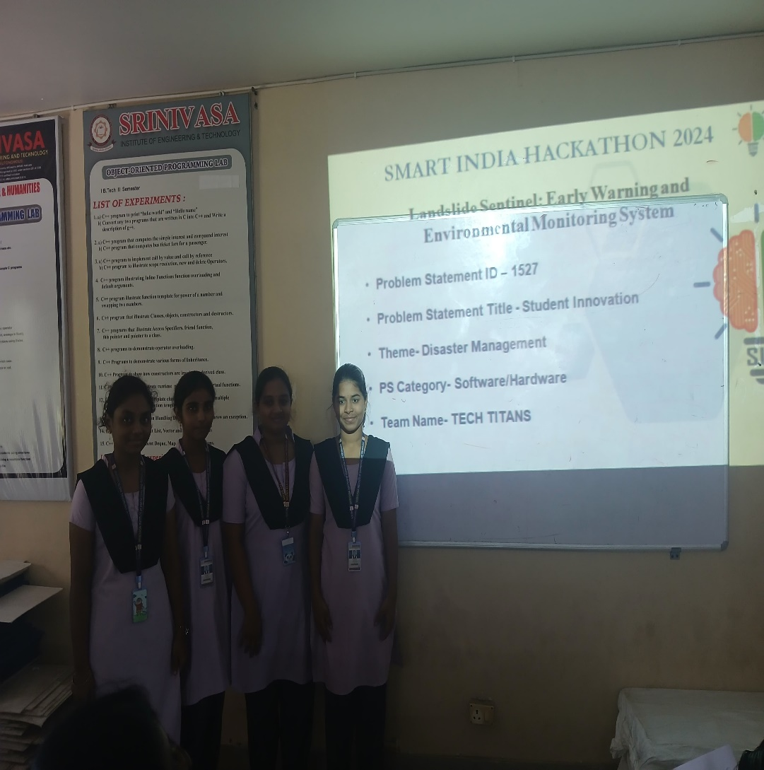
SMART INDIA HACKTHON-2024 (8 Bathes)

Slide 17
STUDENT ACHIEVEMENTS
No of Students completed Internship : 71
No of Students applied for Minor Degree : 12 (2021-2025) Batch
No of Students applied for Minor Degree : 22 (2022-2026) Batch
No of students completed NPTEL Certification Course : 48
AIML students participated in Smart India Internal Hackathon that was conducted on October , 2024 and was promoted to present their idea for next level
Students certificate from ICT Academy – 12
Students placement : 45

Slide 18
RESULT ANALYSIS III-I (SR21) AIML (2021-25 Batch)
Academic Year | Pass %
2023-24 | 82.86

Slide 19
RESULT ANALYSIS III-I (SR21) AIML (2021-25 Batch)
Subject | Faculty Name | Pass %
Operating Systems | Mr. RAMA KRISHNA RAJU | 97.14
Machine Learning | Ms. V. SAI PRIYA | 98.57
Data Warehousing and Data Mining | Dr. R.J.MATHEW | 94.29
Design and Analysis of Algorithms | Dr. K.VIJAY KUMAR | 90.00
Principles of Communication | Mr. M.MARIMURTHU | 90.00
Total Pass Percentage |  | 82.86

Slide 20
RESULT ANALYSIS III-II (SR21) AIML (2021-25 Batch)
Academic Year | Pass %
2023-24 | 84.29

Slide 21
RESULT ANALYSIS III-II (SR21) AIML (2021-25 Batch)
Subject | Faculty Name | Pass %
Compiler Design | Mrs.V.SAI PRIYA | 91.43
Deep Learning | Mrs.SRAVANTHI | 100.00
Computer Networks | Mr.M.RAMAKRISHNA | 97.14
Software Project Management | Mr.G.SATISH | 88.57
Sustainability Concepts in Civil Engineering | Ms.P.LAVANYA | 100.00
Total Pass Percentage |  | 84.29

Slide 22
RESULT ANALYSIS II-I (SR21) AIML (2022-26 Batch)
Academic Year | Pass %
2023-24 | 87.30

Slide 23
RESULT ANALYSIS II-I (SR21) AIML (2021-25 Batch)
Subject | Faculty Name | Pass %
Fundamentals of Artificial Intelligence and Machine Learning | Mr.S.PRABHUDAS | 100.00
Object Oriented Programming through Java | Mrs.JYOTHI | 98.41
Computer Organization | Mr.G.SATISH | 96.83
Data Structures | Dr.K.V.SUBRAMANIAN | 90.48
Probability & Statistics | Dr. R.J.MATHEW | 98.41
Total Pass Percentage |  | 87.30

Slide 24
RESULT ANALYSIS II-II(SR21) AIML (2022-26 Batch)
Academic Year | Pass %
2023-24 | 90.32

Slide 25
RESULT ANALYSIS II-II (SR21) AIML (2021-25 Batch)
Subject | Faculty Name | Pass %
Data Base Management Systems | Mr. M.RAM KRISHNA RAJU | 100.00
Advanced AI Techniques | Mrs. V.SAI PRIYA | 96.77
Software Engineering | Ms . K. ARUNA SREE | 100.00
Formal Language and Automata Theory | Dr. K.VIJAY KUMAR | 95.16
Mathematical Foundations of Computer Science | Dr. R.J.MATHEW | 95.16
Total Pass Percentage |  | 90.32

Slide 26
Academic Toppers (2021-2025 Batch)
S.No | Roll Number | Name of the student | Percentage | Semester
1 | 216N1A6105 | BHUPATHIRAJU DEEKSHITHA MANI | 8.75 | III-I
2 | 216N1A6115 | ILLA VIDYA SAHITHI | 8.71 | III-I
1 | 216N1A6115 | ILLA VIDYA SAHITHI | 8.74 | III-II
2 | 216N1A6105 | BHUPATHIRAJU DEEKSHITHA MANI | 8.73 | III-II

Slide 27
Academic Toppers (2022-2026 Batch)
S.No | Roll Number | Name of the student | Percentage | Semester
1 | 226N1A6101 | BASA SHIRIDI SAIRAM | 9.0 | II-I
2 | 226N1A6125 | M. PUJITASRI | 8.9 | II-I
1 | 226N1A6101 | BASA SHIRIDI SAIRAM | 9.25 | II-II
2 | 226N1A6108 | D.YAMALIKA | 9.16 | II-II

Slide 28
STRATEGIC PLAN AND GOALS
Establishment of Professional Society like ACM in the Department
Encourage more number of Students to register for Online Certification Programs like NPTEL, SWAYAM etc
Encouraging Faculty to improve their Knowledge by participating in FDP, Webinars, Conferences etc.,
Encourage faculty to improve their Academic Qualification
Planning to conduct Hands-on Training Workshop on Machine Learning to students in the month of January

Slide 29


